Slide 1
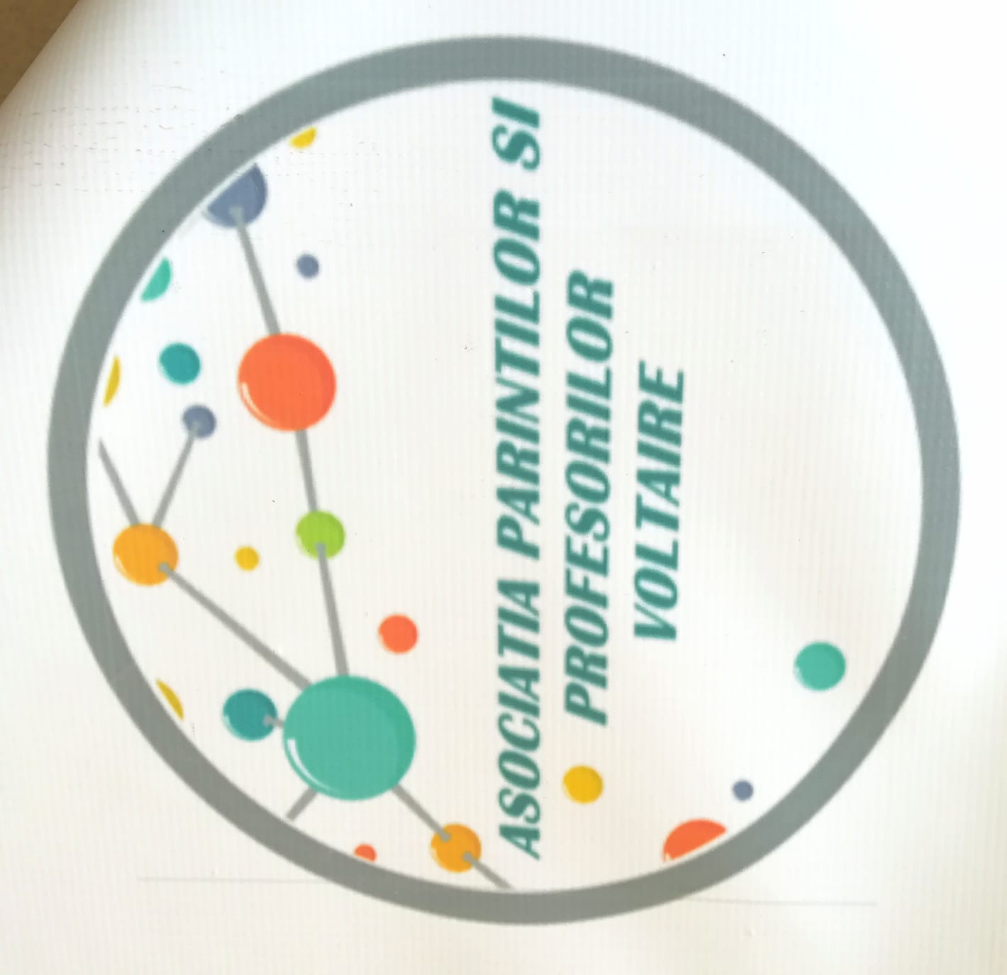
"Voltaire parents' and teachers' association“, Craiova, Romania
Prof. dr. Popi Dorina Loredana
Parent Criveanu Emilia

Slide 2
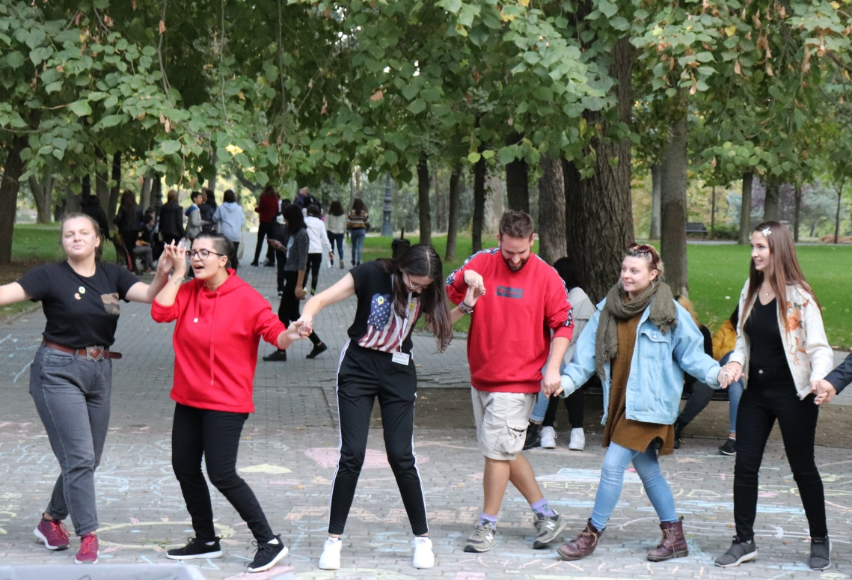
About us
"Voltaire parents' and teachers' association" is a young association, founded in 2017, at the initiative of 8 people -4 teachers and 4 parents of the students from "Voltaire" High School.
All the teachers of Voltaire High school (32 teachers) and all the parents of the students of "Voltaire" High School (more than 400) are part of the association.

Slide 3
About us
From the beginning, according to the management plan of the association, its purpose was to create a close partnership among students, parents, teachers of the "Voltaire" High School, the Ministry of Education and Research, Dolj County School Inspectorate, other local, national and international educational units, other public institutions, educational unions and other national and international organizations/associations.
The partnership underlying the functioning of the association aims to support the modernization of the teaching act by continuously improving the teaching staff with teaching methods, learning, innovative evaluation and increasing the quality of education, in accordance with the European Union standards.

Slide 4
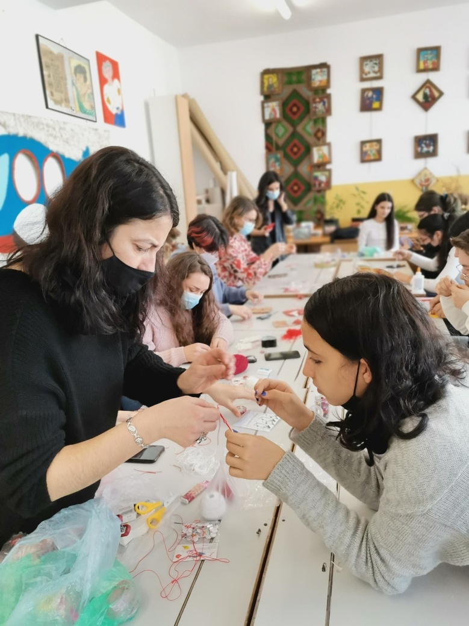
About us
Also, the partnership promotes the interests of students, parents and teachers as a unitary whole, cultivating a partnership relationship among them, including the financial support for students with outstanding results in various competitions schools, Olympics and for students from disadvantaged families.
In addition, this collaboration aims to involve parents in all aspects of the educational life of the school.

Slide 5



Our activities
Among the activities of parents and teachers who are members of the association carried out since its beginning, we mention only some of the most important:
- Cultural activities in the European projects of Voltaire High school in which students, teachers and parents collaborated with international partners - students and teachers from partner countries, for example, Erasmus + projects „Discovering the European cultural heritage through the 5 senses”, „Educated and active citizenship”, „Terapi”
Facebook-https://www.facebook.com/Empower-Update-Upgrade-
100303178471028
Websites of the projects
-https://voltaire-app-euu.weebly.com/
- https://voltairemdi.weebly.com/about.html
http://www.liceulvoltaire.ro/pagini/proiecte.htm

Slide 6
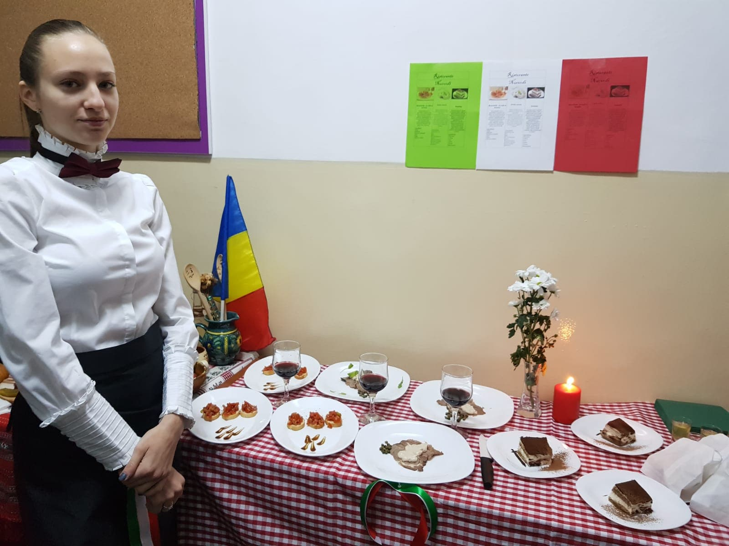
Our activities
“ World Cuisine ”- every school year, on the occasion of Voltaire Highschool Day, the association supports the activities organized within this special event, helping students to prepare traditional food and dress traditionally for a country that was won in a lottery (mostly European countries, but not only).

Slide 7
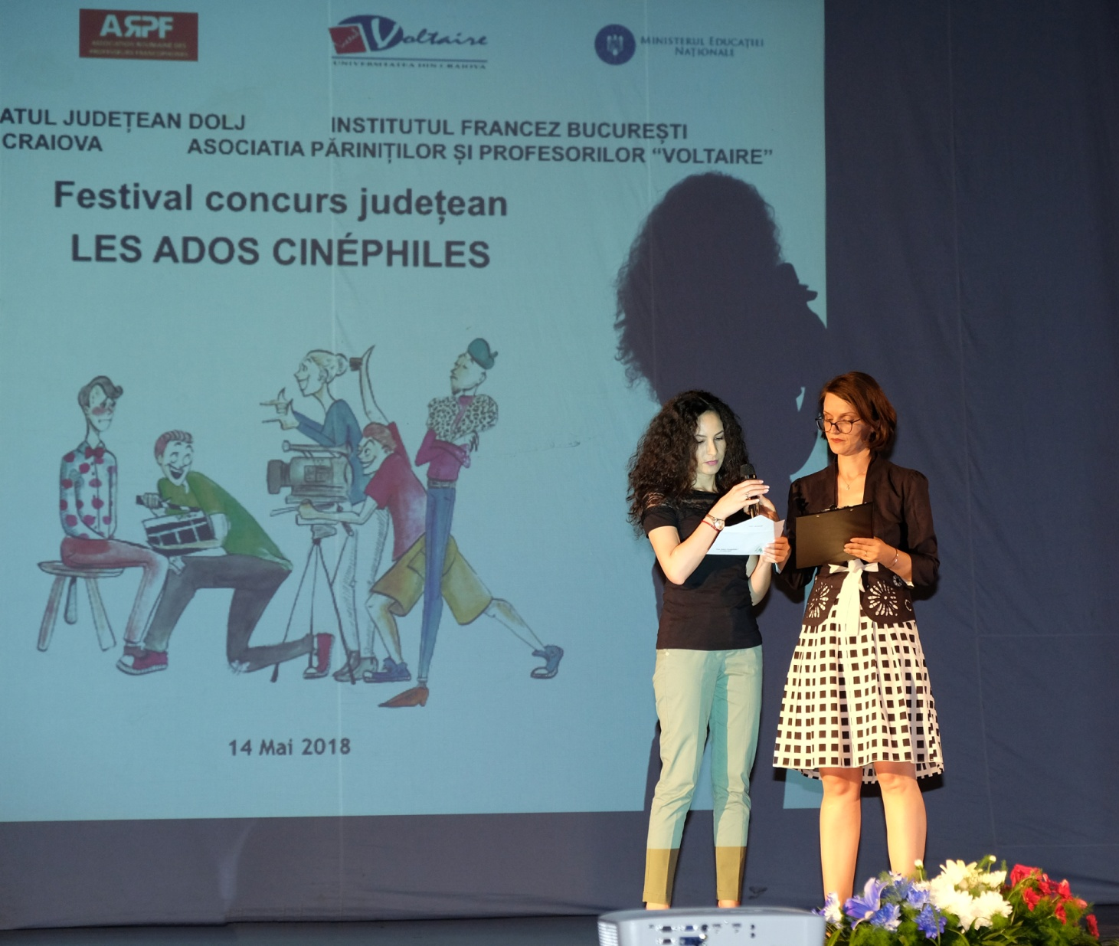
Our activities
Financial support for "Les Ados cinephiles" - a short film competition made by students at county level, which promotes values ​​such as interculturality and social inclusion

Slide 8
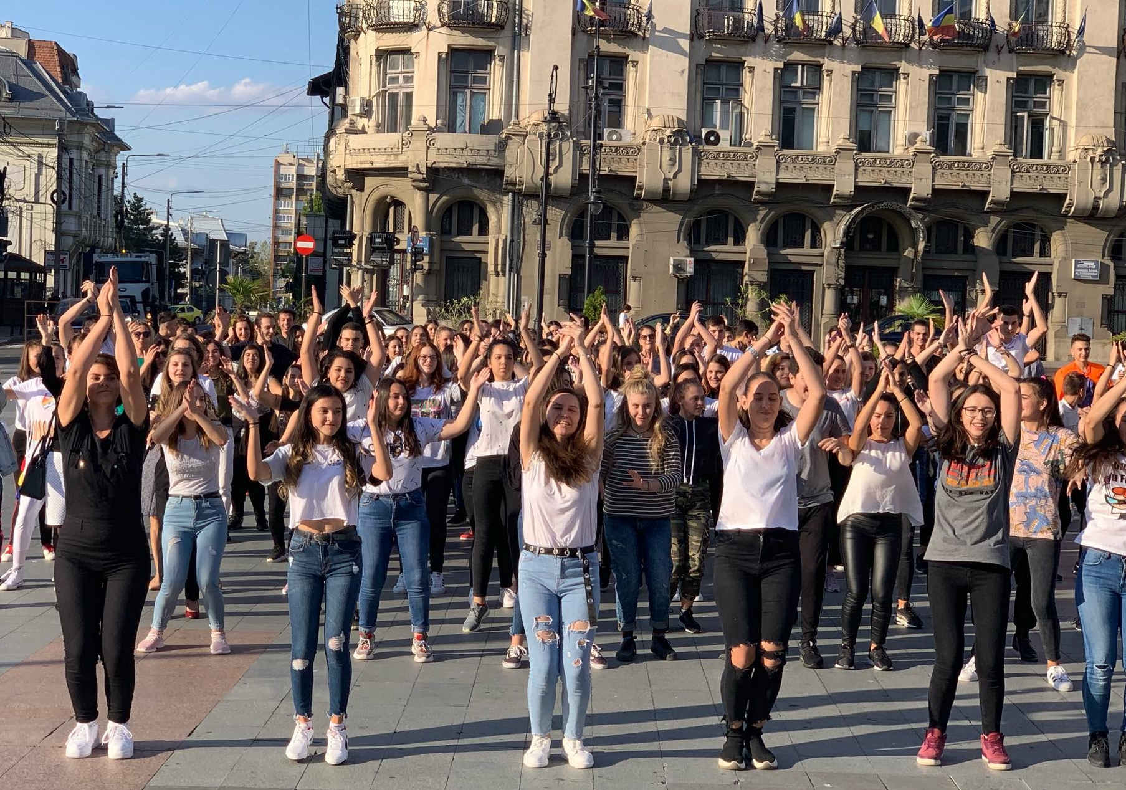
Our activities
"Euroscola" 2019 - a competition for schools at national level in which students, parents and teachers actively participated in all types of educational activities which had as motto "Stepping up skills" - which proved that learning can take place in all kinds of environments, for example a Flashmob in our city center attended by parents, teachers, students who danced synchronously on a song in the French language.

Slide 9
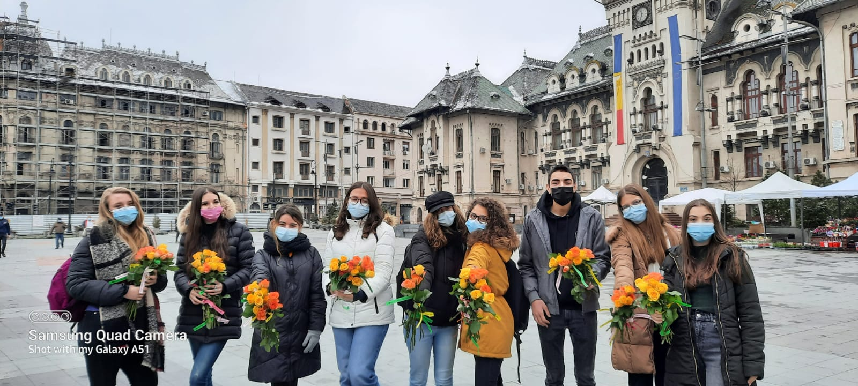
Our activities
Socialization activities on the occasion of the 1st and 8th of March, when the parents were pleasantly surprised by the activities proposed by the teachers of the association and their children.

Slide 10
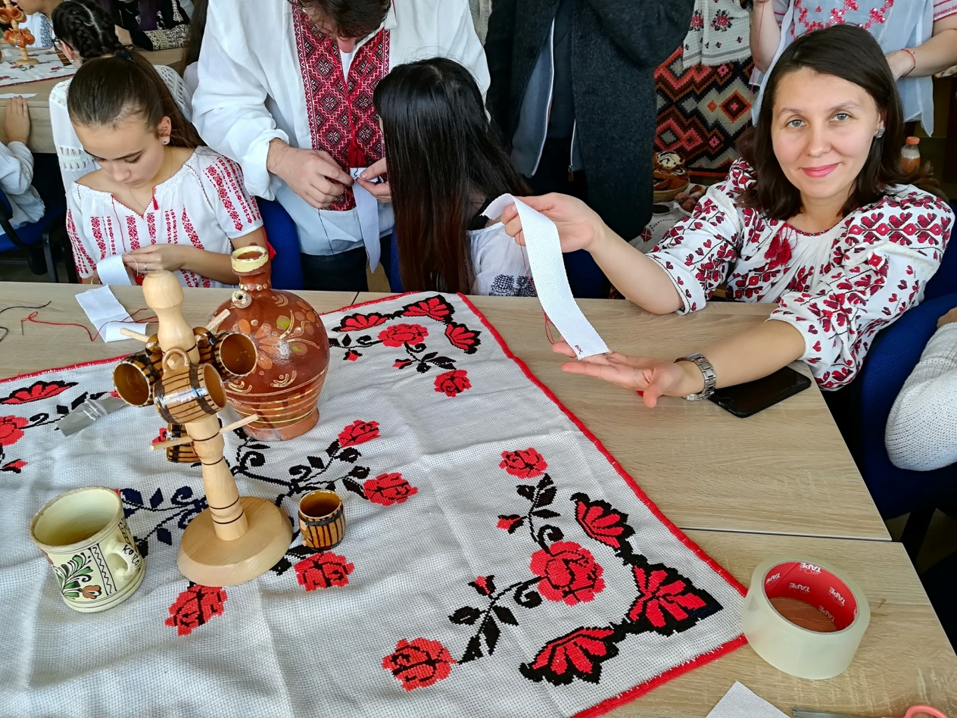
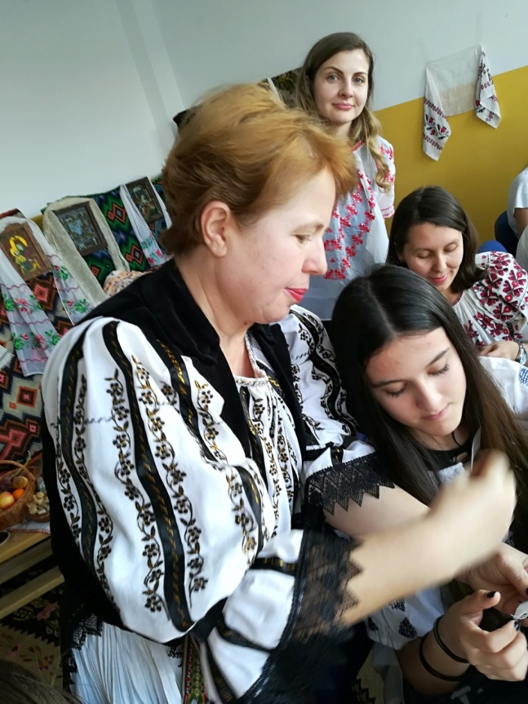
Our activities
Traditional activities “La sezatoare" - an intergenerational activity that had the aim of showing the importance of preserving the Romanian traditions and transmitting them to the new generation

Slide 11
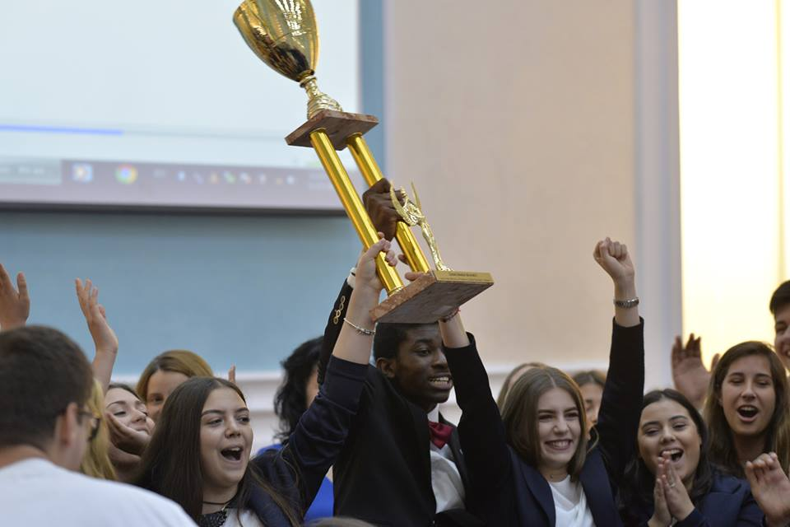
Our activities
"Youth competition" that seeks to enhance intelligence and creative potential of young people

Slide 12
Our third Erasmus+ project
“ Include All! Inform all! Invest in all!“
Include-i pe toti! Informeaza-i pe toti! Investeste in toti!
Erasmus+ Project no. 2024-2-RO01-KA122-ADU-000279325

Slide 13
The Objectives of the project “ Include All! Inform all! Invest in all!“ are :
Acquiring lifelong learning non-formale and informal methods
Developing entrepreneurial competences
Developing competences of inclusion, active citizenship and adapting to the worldwide social and economical context

Slide 14
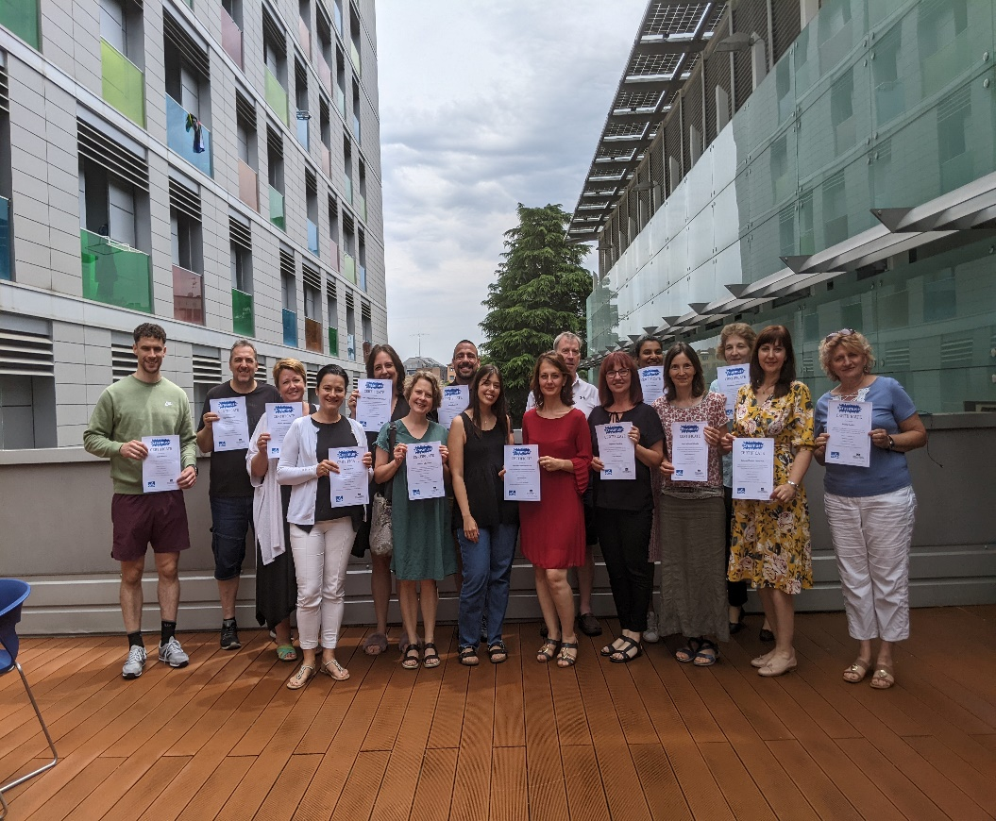
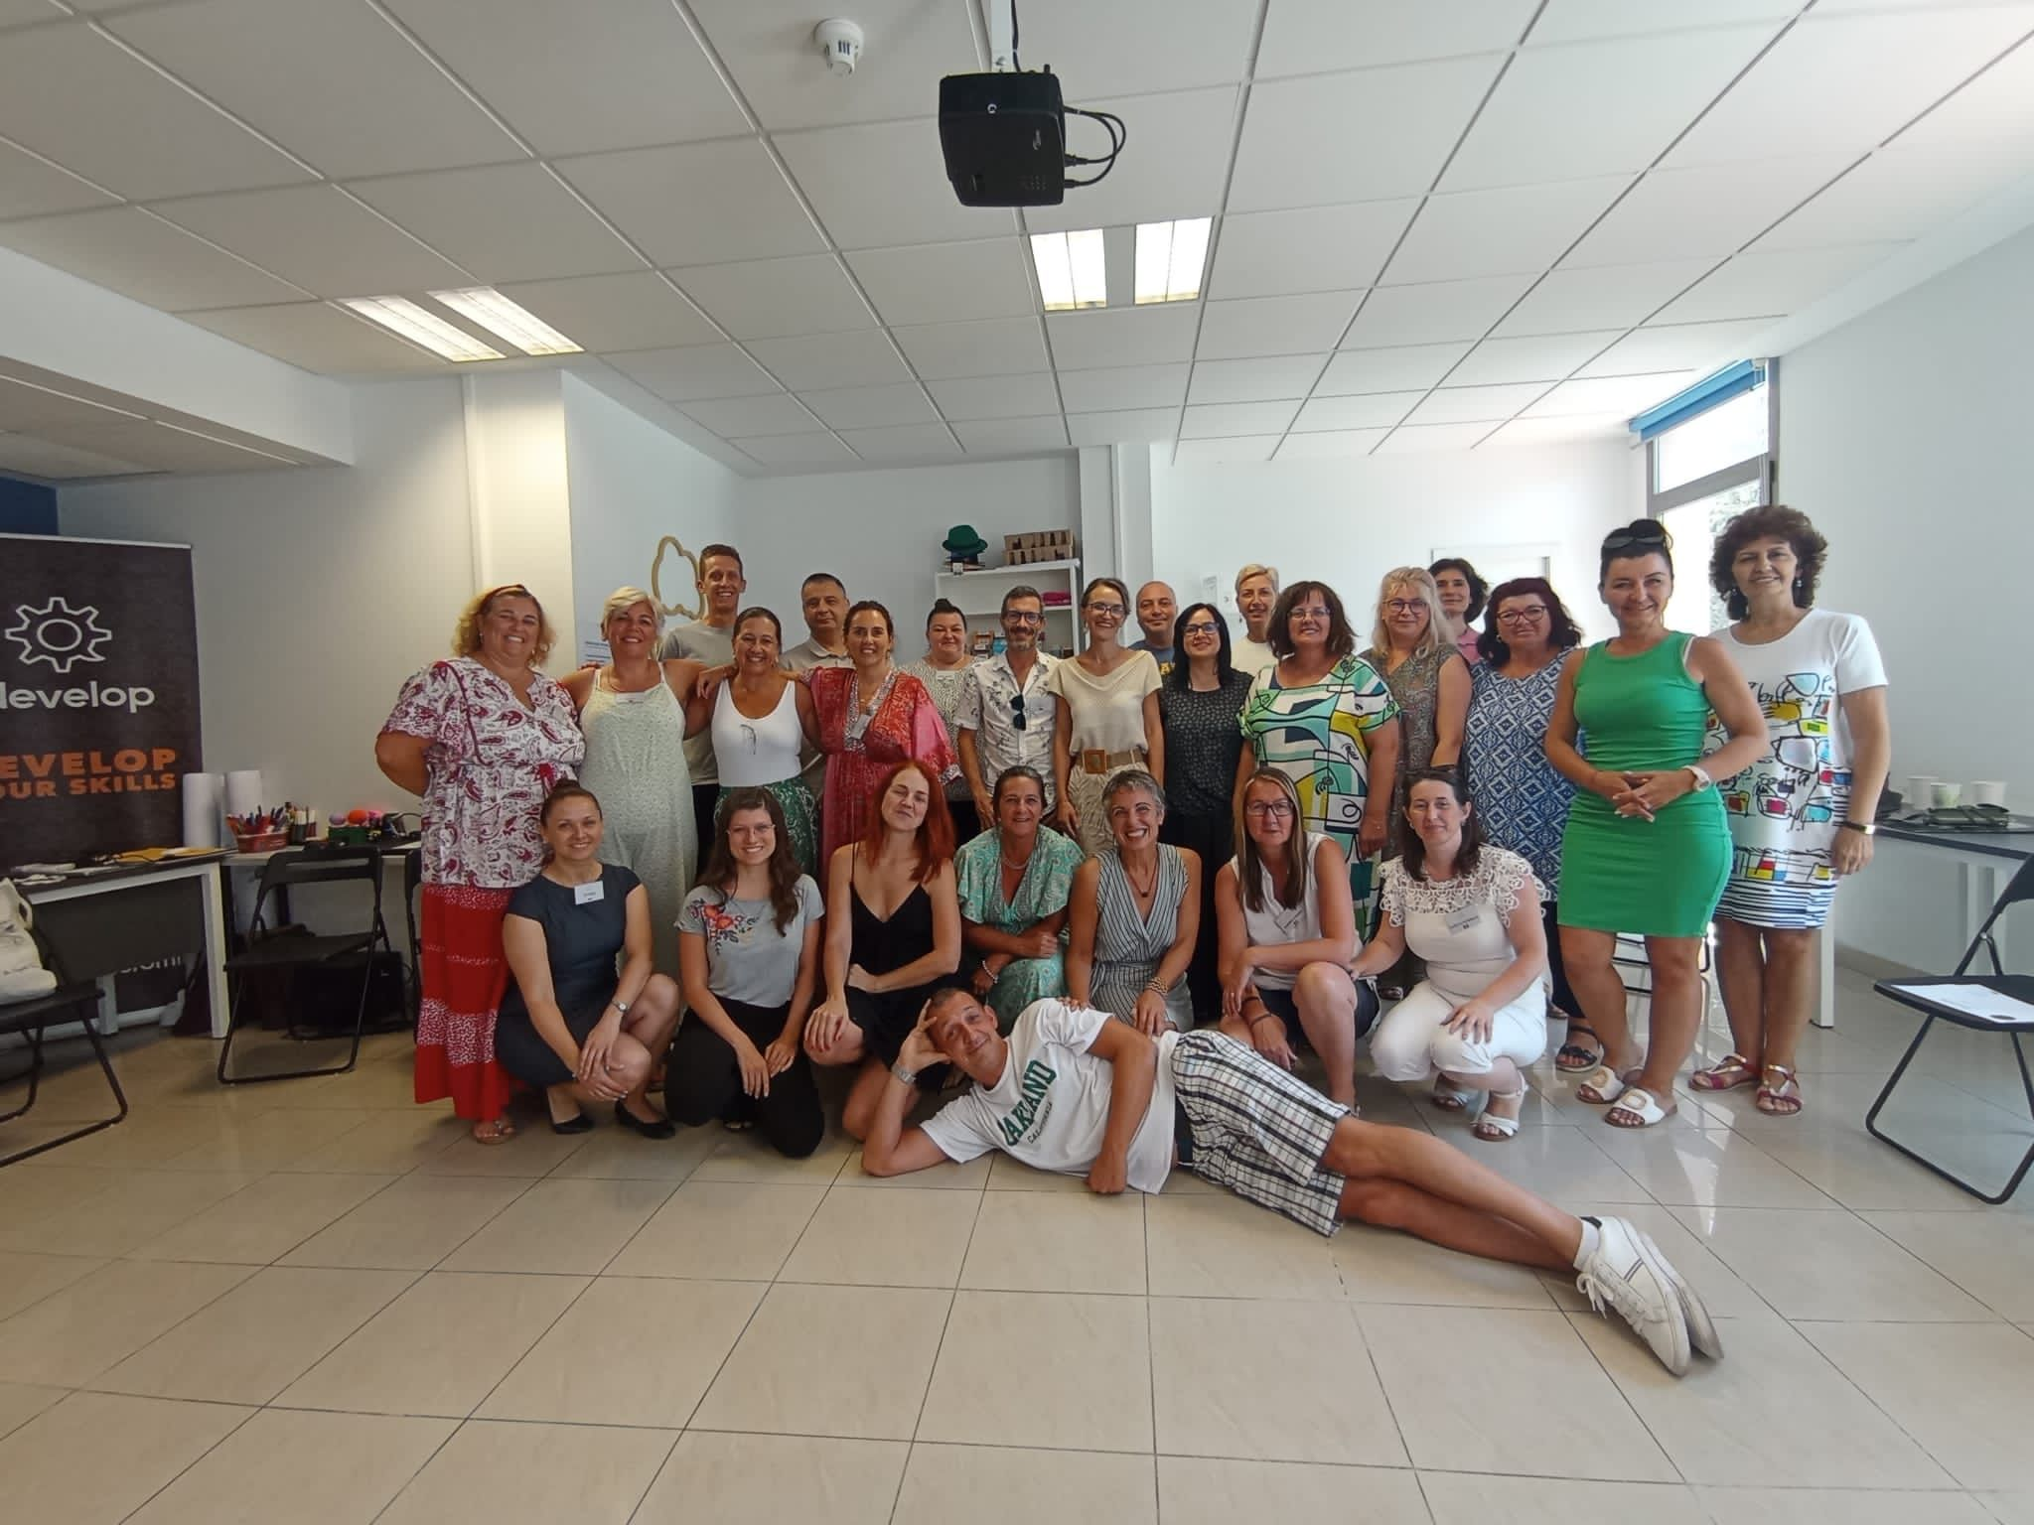
Our second Erasmus + project “Motivate! Develop! Involve!”

Slide 15
“Motivate! DeVELOP! INVOLVE!”
Our project “Motivate! Develop! Involve!”
No. 2022-1-RO01-KA122-ADU-000079766
Had the following objectives:
Training of mentoring skills in the activity with adults
The acquisition of methods and strategies of motivation and self-motivation
Reducing the socio-professional differences between the members of the association

Slide 16
Motivate! DeVELOP! INVOLVE!”
The project has run for a period of 17 months, between 01/06/2022 and 31/10/2023
The financing has been of the maximum amount of 14,395.00 EURO

Slide 17
Motivate! DeVELOP! INVOLVE!”
Training courses:
“Emotional intelligence and coaching skills for teachers, school and adult education staff" course -provider: Erasmus Learning Academy, 7 days, Bologna, Italy-2 participants
"Lifelong Learning: Elements of Wisdom" course -provider: Idevelop Training SL, 5 days, Sevilla, Spain - 2 participants
The course "Adult Educator's Role in a New Reality" -provider: VitaTim, 5 days Corfu, Greece - 3 participants

Slide 18
Motivate! DeVELOP! INVOLVE!”
Information about our Erasmus+ project
https://www.liceulvoltaire.ro/pagini/Anunt%20selectie%20Motiveaza%20Dezvolta%20Implica.pdf
https://voltairemdi.weebly.com/about.html
https://www.facebook.com/profile.php?id=100089035595164

Slide 19
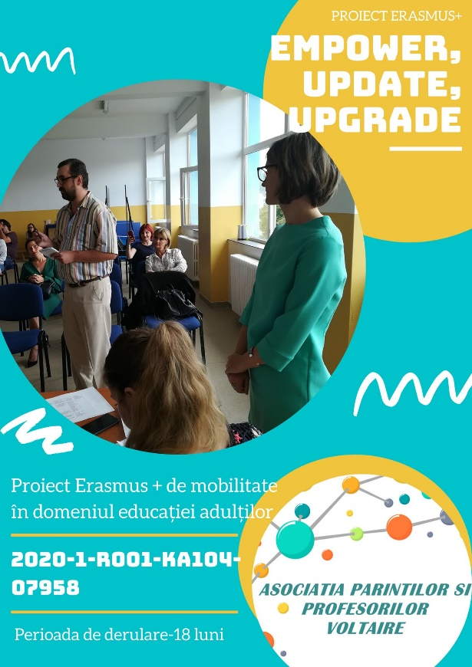
"Empower, Update, Upgrade",
Our first Erasmus+ project

Slide 20
Our First Erasmus + project
The project "Empower, Update, Upgrade", submitted at the deadline of February 5, 2020, extended to February 11, 2020, by Voltaire Parents’ and Teachers’ Association was approved with no. 2020-1-RO01-KA104-07958.
The general objective of the project was to make the collaboration among the members of the Voltaire Parents’ and Teachers’ Association more efficient and also between the association and the community.

Slide 21
Thank you for your attention!

